Slide 1
TDD in TypeScript
Test Driven Development
DEV3LSOLUTIONS.COM
Notes:
8 hours – 1 hour lunch break
7 hours = 420 minutes
10-minute break every hour
- Try to break on exercise to catch up anyone

Slide 2
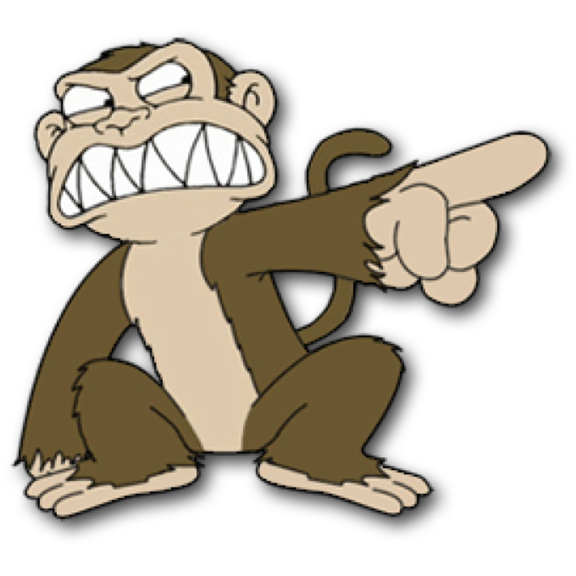

Justin Beall
Justin Beall
15 Years Software Engineering
CSM, A-CSD, CSPO, SA
Favorite language, Python
15 Years Software Engineering
CSM, A-CSD, CSPO, SA
Favorite language, Python
2
Notes:
2m : 2m

Slide 3
INTRODUCTIONS
INTRODUCTIONS
Notes:
18m : 20m
Who are we?
Learning environment, feel free to ask questions.
What is everyone’s familiarity with the stack / software development.
Breakout rooms
Regular breaks – shoot for 10 till the hour, leaves room for questions and catch up as necessary
Who are you?
What do you do?
What do you want to learn in class?
Tell me about your automation experience

Slide 4
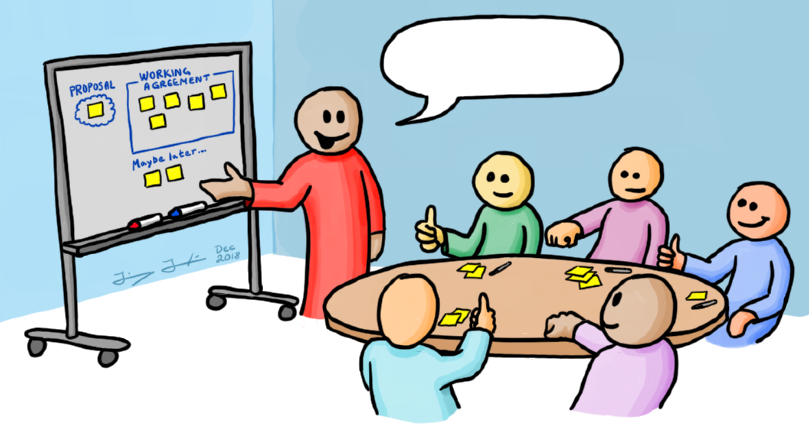

Course Objectives
Working Agreements
Understanding the Benefits of TDD
Learning Good Testing Practices
What code smells to look for
Level up your knowledge!
Start / End Time
- Respect your peers; don’t be late
Be Present
- Participate
Own your learning
- Speak up if you don’t understand something
You aren’t done until the (virtual) person next to you is done
Code (1) Make it work; (2) Make it better
Notes:
5m : 25m

Slide 5

Course Objectives
Summarize the value of TDD
Use TDD to solve Katas
Integrate TDD Into Daily Work
Recognize the benefit of writing clean, maintainable code
Notes:
5m : 30m

Slide 6
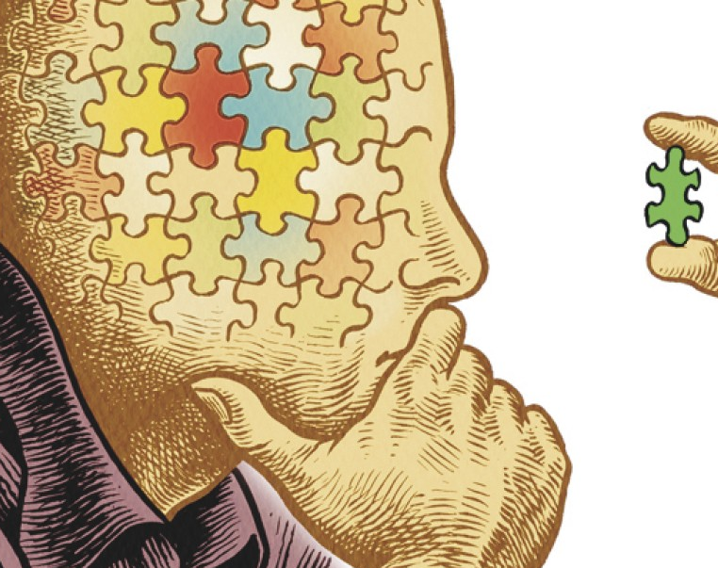
Why Are We Here?
Notes:
5m : 35m
How is testing performed currently?
Why Test First, not Test After?
We are here to learn to write tests and use those tests to drive our design.
-- war stories
Has anyone been on a project using TDD?
Has anyone worked on a legacy project?
Touch one thing over here, and something breaks over there

Slide 7
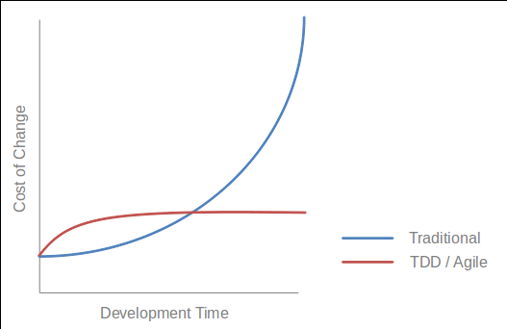
What is Test Driven Development?
A Programming Discipline
High-feedback incremental coding technique
Write tests as specs, prior to code
Core of the cycle:
Write a test
Write the code to make the test pass
Notes:
10m : 35m
--- What
Test-driven development (TDD) is a software development process that relies on the repetition of a very short development cycle:
Requirements are turned into very specific test cases, then the software is improved to pass the new tests, only. This is at the Unit Level (Classes and Methods in Code).
This is opposed to software development that allows software to be added that is not proven to meet requirements.
--- Discipline
TDD is a discipline, disciplines are arbitrary or at least they have arbitrary components to them. Disciplines have arbitrary behaviors that are driven by some substantial motives.
For example, how do doctors wash their hands before surgery? Do they just go in there and wash hands like normal people do? no, there is discipline something like this. There is special brush, soap and they turn on the water and it is ten strokes across the side of fingers. You understand why they do that, there is motive behind that, but is ten the right number? could it be twelve or eight, it is arbitrary. It is just a guess, ten probably enough.
The discipline is motivated by something real. The discipline of TDD works like this, There are three rules.
--- Double Entry Bookkeeping
We produce documents filled with code - arcane symbols in strange shapes and structure, no one else can read them only programmers.
What other field, employment has problem like that? Where they construct the document that are arcane and full of symbols and every symbols have to be correct. Accountants. How do accountants make sure that their documents are correct? They have a discipline that was invented 500 years ago, called Double-entry bookkeeping. They enter everything twice. TDD is Double-entry bookkeeper, is exactly the same discipline done for precisely same reason, we say everything twice, once on test side, once on production code side, they follow execution, complimentary execution pathways they wind up with zero, zero test failed. Same discipline, Same reason, Same outcome.

Slide 8
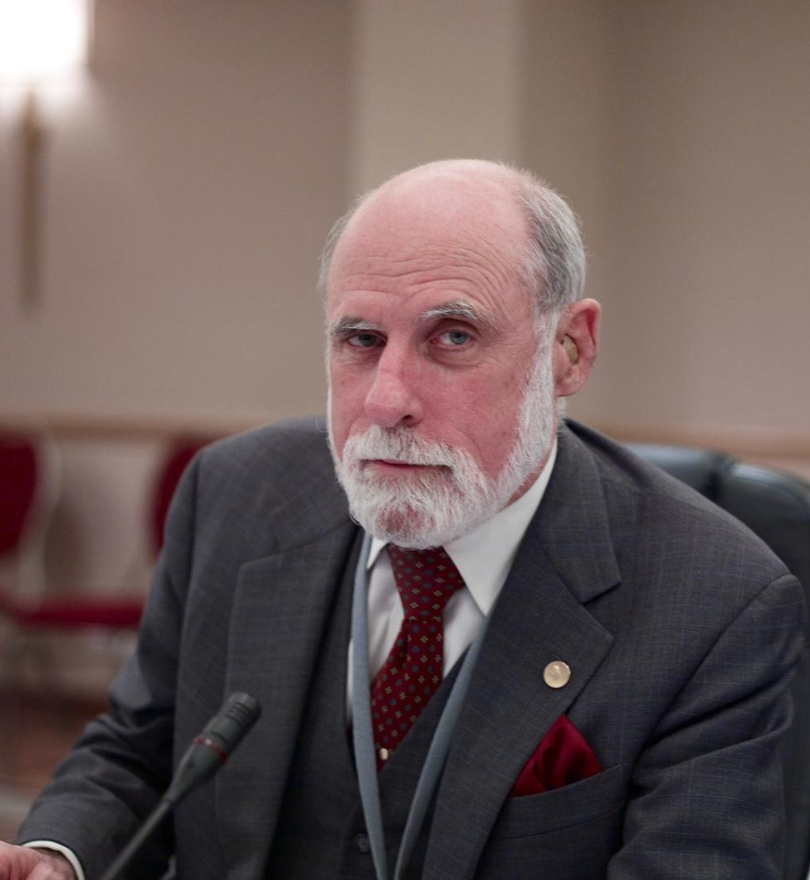
Test First is NOT new
“A software system can best be designed if the testing is interlaced with the designing instead of being used after the design.” - Professor Alan J. Perlis
NATO SOFTWARE ENGINEERING CONFERENCE 1968
Notes:
5m : 40m
An American computer scientist and professor at Purdue University, Carnegie Mellon University and Yale University. He is best known for his pioneering work in programming languages and was the first recipient of the Turing Award.
If thought leaders believed this back in the late 60’s, why is it not common place today?

Slide 9
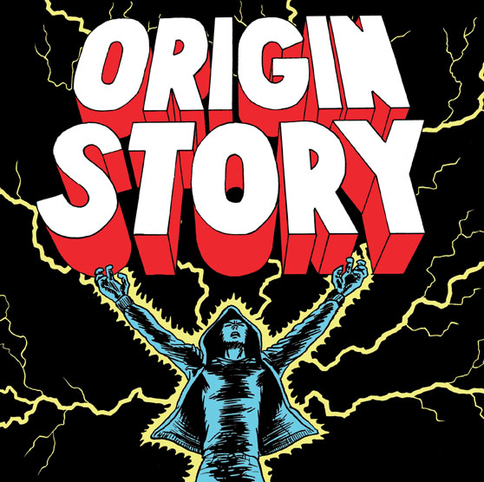
Kent Beck’s "rediscovering" TDD
“The original description of TDD was in an ancient book about programming. It said you take the input tape, manually type in the output tape you expect, then program until the actual output tape matches the expected output. After I'd written the first xUnit framework in Smalltalk I remembered reading this and tried it out. That was the origin of TDD for me. When describing TDD to older programmers, I often hear, "Of course. How else could you program?" Therefore, I refer to my role as "rediscovering" TDD.”
Notes:
5m : 45m
American software engineer Kent Beck, who is credited with having developed or "rediscovered" the technique, stated in 2003 that TDD encourages simple designs and inspires confidence.
The SUnit (later to be known as xUnit) was designed by Kent Beck in 1998
---
Automated unit testing nothing new
But writing the tests incrementally and first is
Automation originally devised by Ward Cunningham
Honed by Kent Beck in Smalltalk
Incorporated as a practice of Extreme Programming (XP)

Slide 10
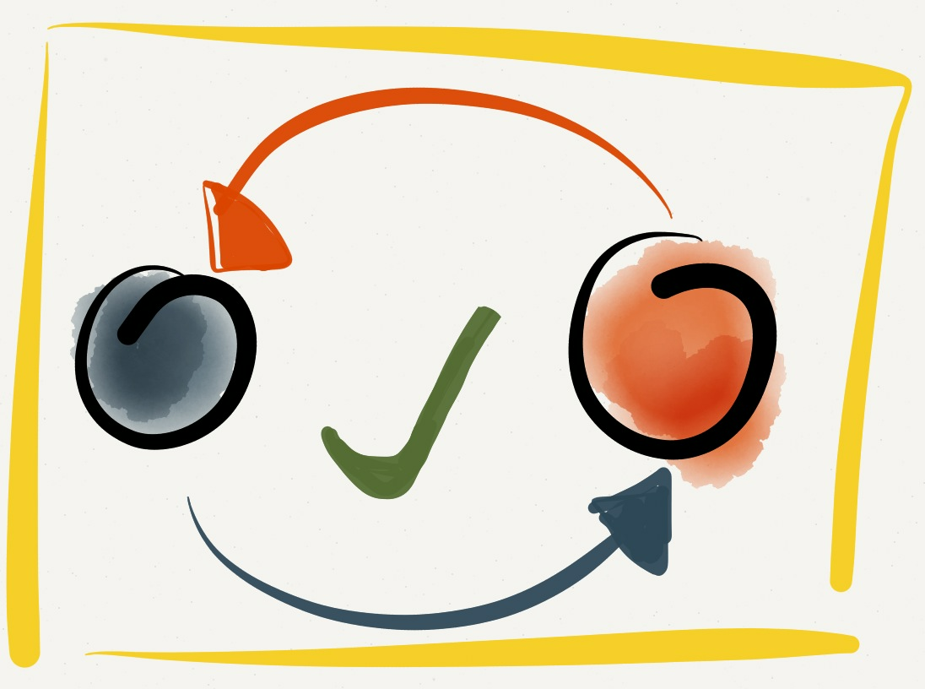
The Three Laws of TDD
1. You are not allowed to write any production code unless it is to make a failing unit test pass.
2. You are not allowed to write any more of a unit test than is sufficient to fail; and compilation failures are failures.
3. You are not allowed to write any more production code than is sufficient to pass the one failing unit test.
Notes:
10m : 55m
Test Driven Development as described by Uncle Bob Martin
Break down each one of the laws and discuss what it means. “Following these laws perfectly doesn’t always make sense.
Sometimes you’ll write a larger test.
Sometimes you’ll write extra production code.
Sometimes you’ll write tests after you’ve written the code to make them pass.
Sometimes it’ll take more than two minutes to go around the loop.
The goal isn’t perfect adherence to the laws—it’s to decrease the interval between writing tests and production code to a matter of minutes. “ - Uncle Bob

Slide 11
The Three Laws of TDD
1. Only write production code to make a failing unit test pass
2. Only write enough of a unit test to make the test fail
3. Only write enough implementation to make failing test pass
Notes:
0m : 55m
Rules simplified As a discipline, what do we get by following these laws?

Slide 12

Doing TDD
A skill which you must learn and practice - Expect it to be initially awkward
Expect some level of addiction - Fast feedback & Green Tests = more dopamine!
Notes:
5m : 60m
Like any new skill – initially writing tests can be awkward Typically used to diving right into problem solving through implementation Writing a test first forces you to think about the expected outcome of a VERY small step
As you get into a rhythm, every time you make a new test pass – it starts building up excitement

Slide 13

BREAK 10:15
Notes:
10m : 70m

Slide 14
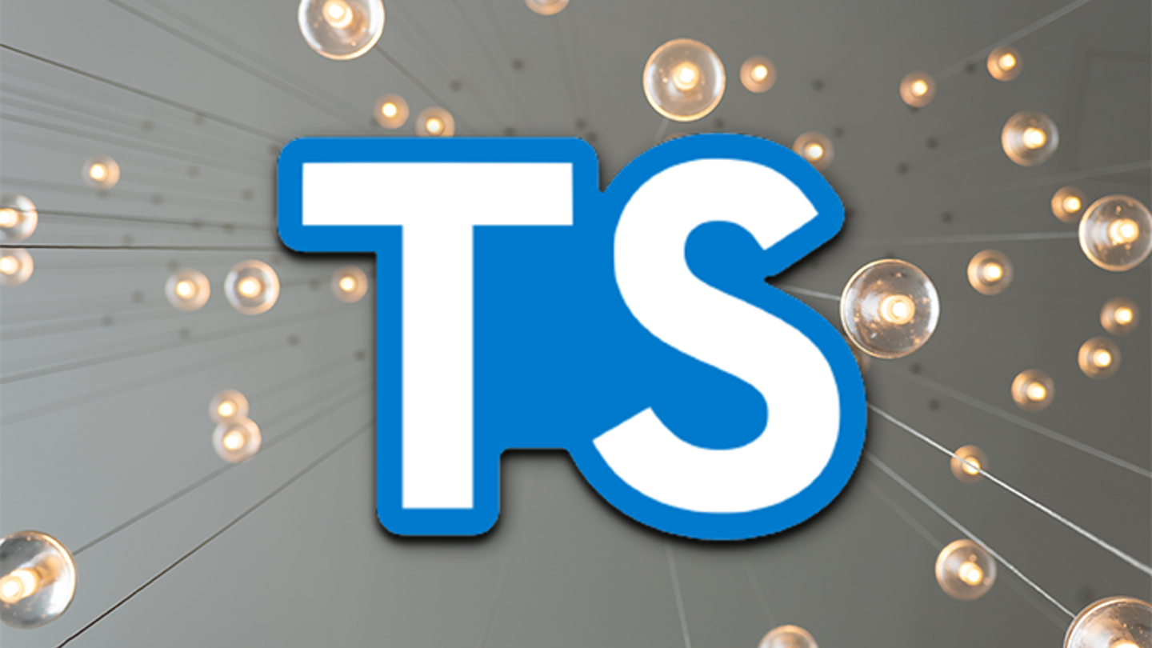
TypeScript Overview
00_typescript
Notes:
15m : 85m
Make sure everyone has computer configured and runnable.
If we run into problems, pair up and resolve the problems at lunch time.
Review TypeScript.
Walk before you run.
How can we get started?
Make sure everyone can run TypeScript

Slide 15
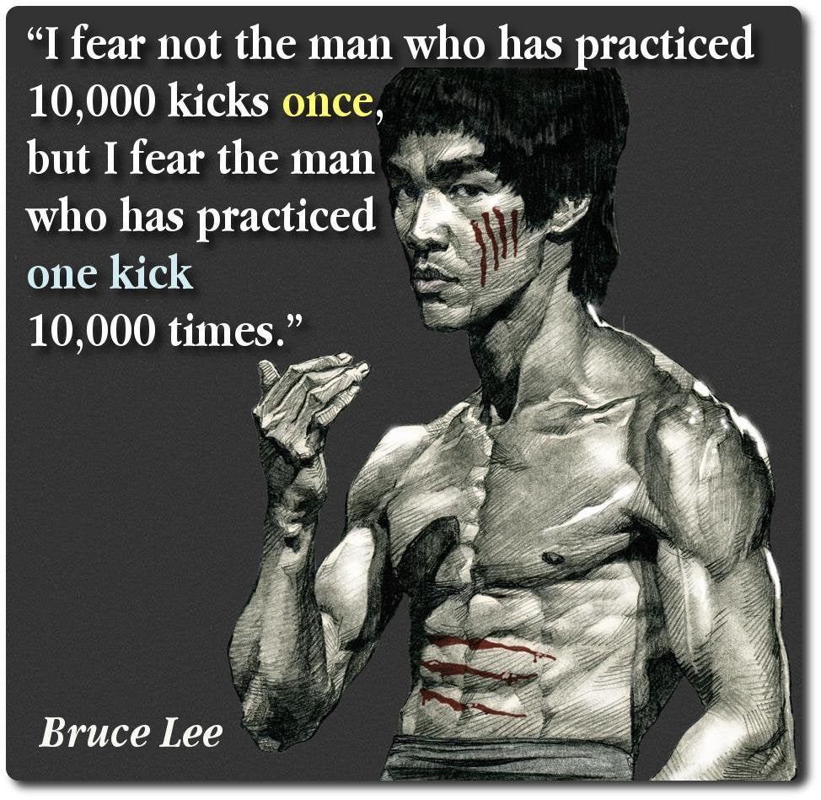
Kata
Notes:
10m : 85m
Kata is a Japanese word meaning "form".
It refers to a detailed choreographed pattern of martial arts movements made to be practised alone.
It can also be reviewed within groups and in unison when training.
It is practised in Japanese martial arts as a way to memorize and perfect the movements being executed.
Does anyone here ever “practice” programming?
- What other professions involve daily practice?
Is anyone aware of any know any programming practice sites?
- “koans” : https://github.com/paytonrules/typescript.koans - “Coding Dojo” : https://codingdojo.org/
- “Hacker Rank” : https://www.hackerrank.com/ - “Exercism.io” : https://exercism.org/

Slide 16
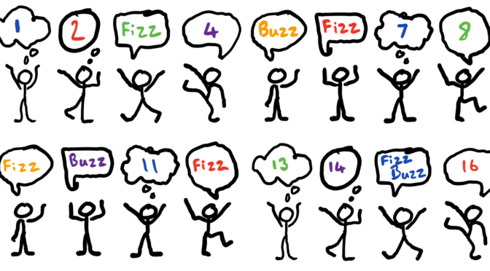
Kata: Fizz Buzz
01_fizz_buzz
Notes:
30m : 115m
http://codingdojo.org/kata/FizzBuzz
Has anyone here ever done FizzBuzz?
Has anyone here ever done FizzBuzz using TDD??
Discuss problem – give hint about the modulo operator “%”

Slide 17

Review
Notes:
10m : 125m
What went well?
What didn’t go well?
Look at some solutions
What if we wanted to use classes?
What if we wanted to use only a function?
What if we didn’t want to use any for loops?

Slide 18

BREAK 1:00
Notes:
10m : 135m

Slide 19
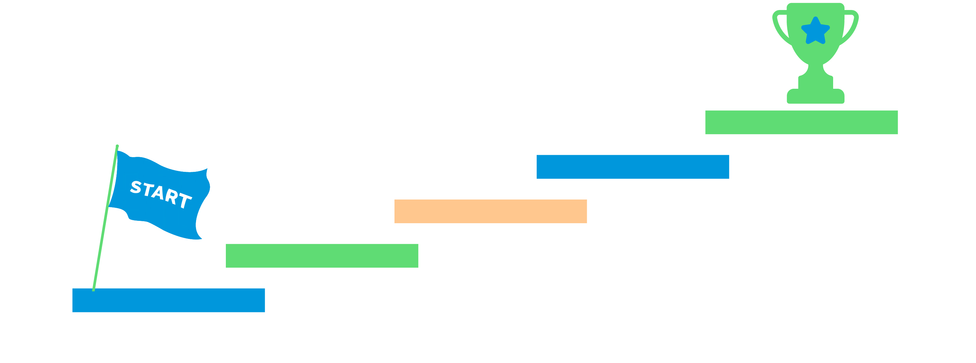
TDD Steps
- Write test (red) - Write implementation (green)
- Write test (red) - Write implementation (green)
…
Notes:
5m : 140m
If it is this simple, then why is it so hard to do?
Why is test first different than test after?
- Which one drives the design?
Where do we begin?

Slide 20
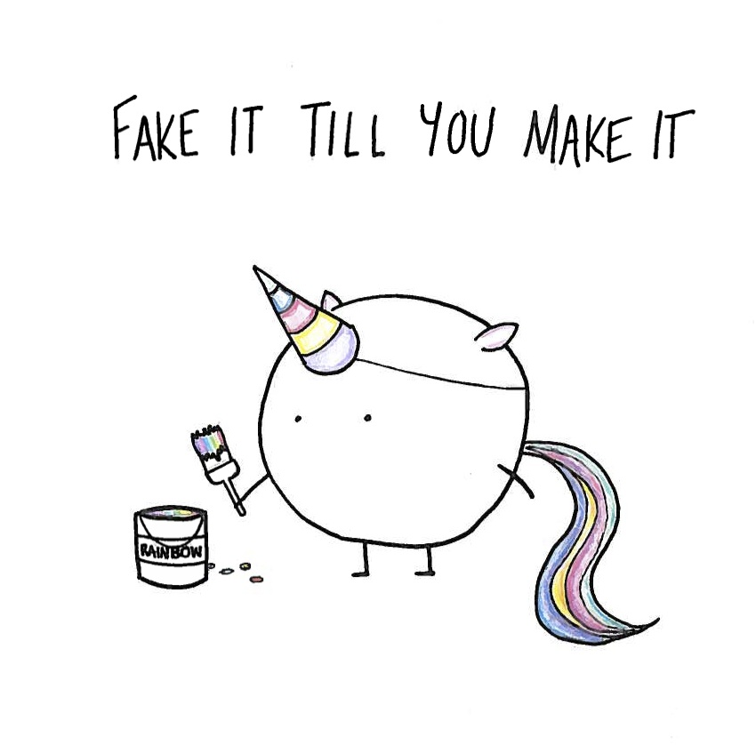
Notes:
5m : 145m
Fake it 'til you make it says to write the simplest possible thing to pass your current tests. Frequently, when you've written a single test case for a new feature, that simplest possible thing is to return a constant. When something that simple satisfies your tests, it's because you don't (yet) have enough tests. So write another test. Now the feature you're developing needs some logic to it. Maybe this time the simplest possible thing is to write very basic if-else logic to handle your two test cases. You know you're faking it, so you know you're not done. When it becomes simpler to write the actual code to solve your problem than to extend your fake to cover yet another test case - that's what you do. And you've got enough test cases to make sure you're writing it correctly.
If you are not used to this, it will drive you insane at first… you know the solution, will require <x> - so why not just implement that?

Slide 21
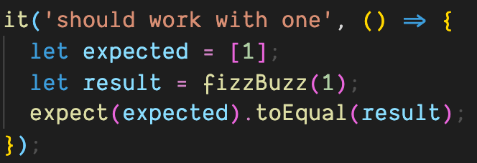
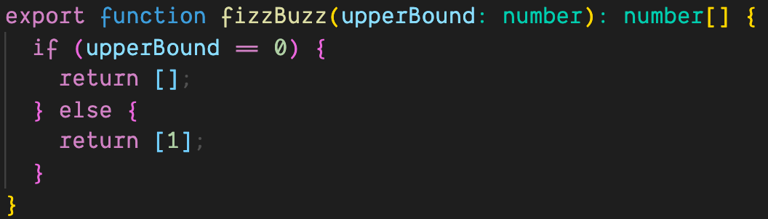
Notes:
5m : 150m
When we look at this, we obviously know this is not the desired solution – but as far as our tests are concerned, this is all the matters
What is the value in this? “Earning Complexity”
Regardless of the implementation, “it should work with one” will ALWAYS pass – having this safety net allows us to expand into much more complicated business object
Where else do we return stubbed results? Front end developing against a non-existent API – we know the shape, we know the expected results, but until complete we just return a static result

Slide 22
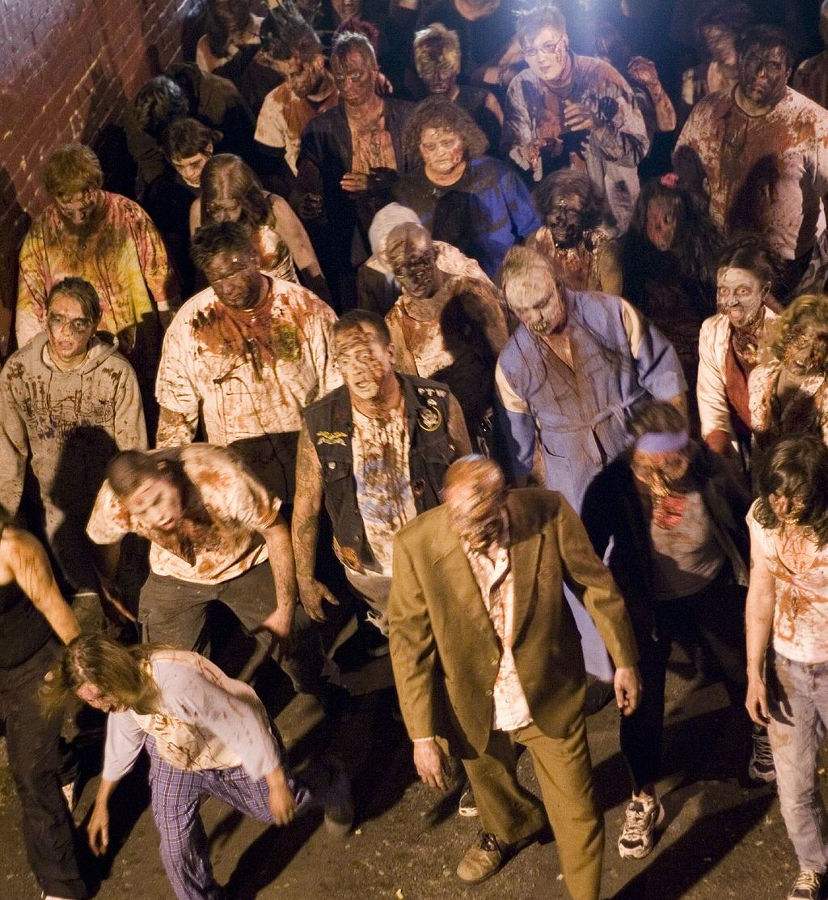
TDD Guided by ZOMBIES
Z – Zero O – One M – Many (or More complex) B – Boundary Behaviors I – Interface definition E – Exercise Exceptional behavior S – Simple Scenarios, Simple Solutions
https://blog.wingman-sw.com/tdd-guided-by-zombies
Notes:
15m : 165m
Have you had a hard time figuring out where to start with Test-Driven Development.
People new to TDD often struggle with what test to write. It’s hard to know where to start or what test to write next. It’s hard to know when you are done, and it’s scary to think you will leave some incomplete code behind
When test-driving, guided by ZOMBIES, the first test Scenarios are for Simple post-conditions of a just created object. These are the Zero cases. While defining the Zero cases, take care to design the Interface and capture the Boundary Behaviors in your test Scenarios. Keep it Simple, both Solutions and Scenarios. You’ll find that hard. Once progress is made on the Zero cases, move to the next special Boundary case, testing the Behavior desired when transitioning from Zero to One. To do so there are likely other Interfaces to define and use in new test Scenarios. Once the Boundary Behaviors between Zero and One (and possibly back to Zero from One) have been captured in tests, move on to start to generalize your design now dealing with More complex Scenarios and Many items being managed. Often there are new Boundary conditions to be concerned with. Finally review your work and make sure you consider and Exercise the Exceptional things that might happen
Go through each step, in regards to Fizz Buzz
http://blog.wingman-sw.com/tdd-guided-by-zombies

Slide 23
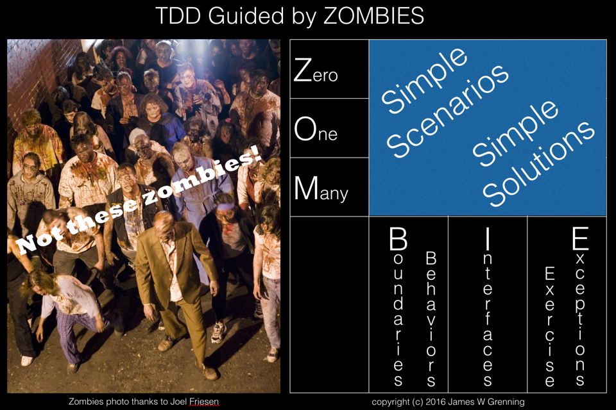
02_fizz_buzz_zombies
Notes:
30m : 195m
Implement Fizz Buzz using ZOMBIES - class follows along, make space for questions

Slide 24

Review
Notes:
15m : 210m
Was that different than how anyone else implemented their Fizz Buzz solution?

Slide 25

BREAK 2:20
Notes:
10m : 220m (Lunch)

Slide 26

TDD Outcomes
Creates testable code by definition - Obvious but significant! - Writing tests after code built usually much harder
Contributes to minimizing defects
Notes:
10m : 230m
What would happen if we worked this way in production?
Has anyone been in a code base that was “difficult to test”?
Why would something be difficult to test?
How would this help us “minimize“ defects?
Just because we wrote a unit test, does not mean the implementation is correct
In the scenario where we touch one thing, and other things break – how would working this way help?

Slide 27
TDD Outcomes
TDD promotes better design - Teaches you how to design isolated pieces
Creates comprehensive developer-level documentation
Development pacing - Constant positive feedback
Tests are living specifications
Notes:
10m : 240m
How does TDD promote better design?
Tests are code examples! Have you ever looked at a piece of code, and wonder how to create a new instance? Or, what the result of a function would be?
How many times has anyone here ever been 100% complete, but have testing left to do? - Is this really “done”?
I thought we didn’t do specifications in agile?

Slide 28
SOLID: Principles of Object-Oriented Design
S - Single-responsibility Principle O - Open-closed Principle L - Liskov Substitution Principle I - Interface Segregation Principle D - Dependency Inversion Principle
Notes:
5m : 245m
Has anyone here heard of SOLID before?
Why would this be important?

Slide 29
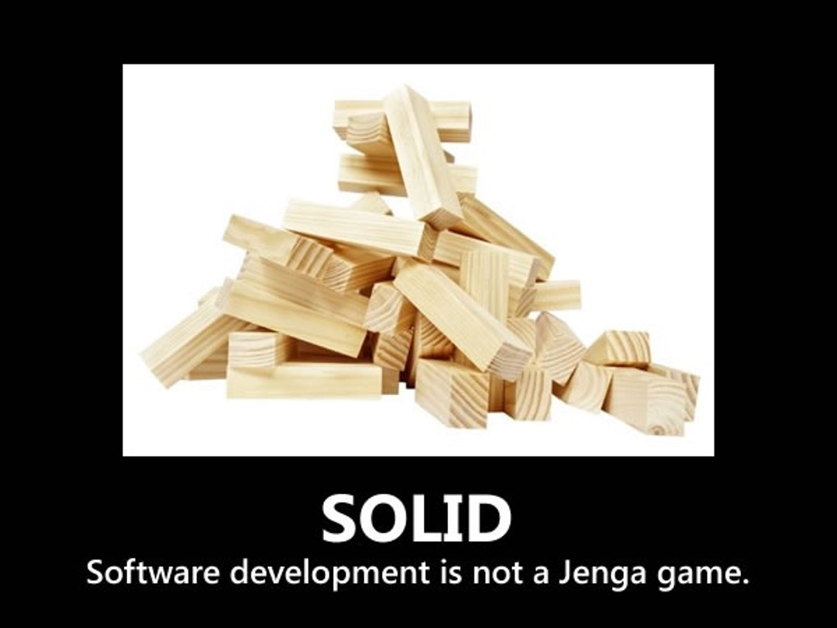
Notes:
5m : 245m
That’s a pretty sweet swiss army knife…

Slide 30
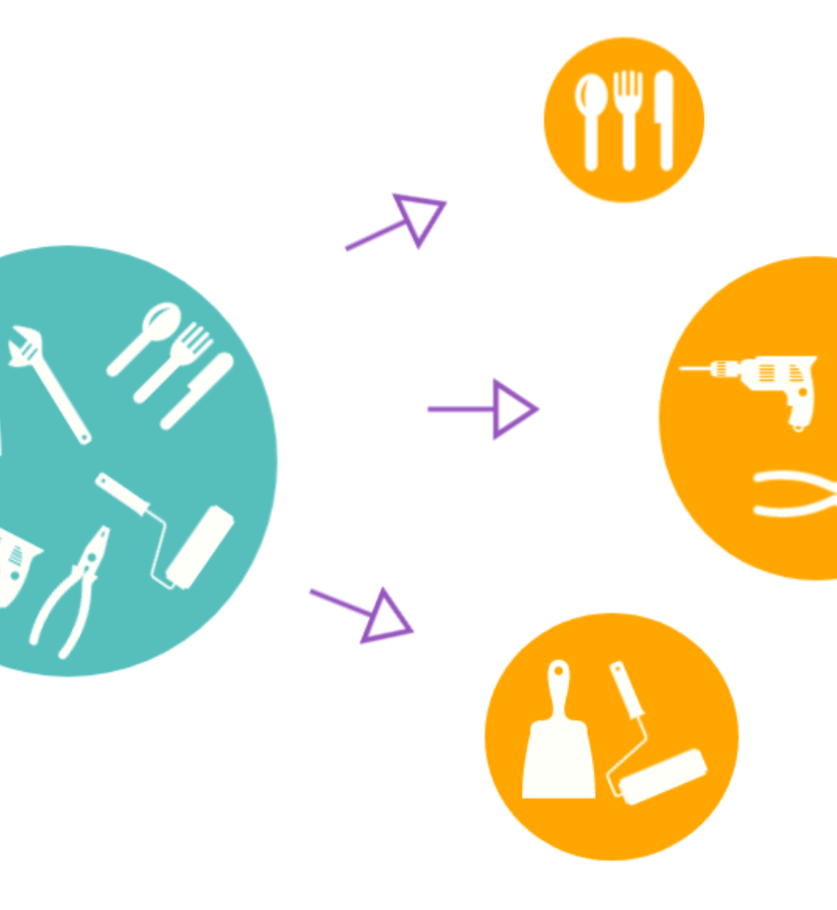
Single-responsibility Principle
A class should have one and only one reason to change, meaning that a class should have only one job.
Notes:
5m : 250m
Single-responsibility Principle (SRP) states - A class should have one and only one reason to change, meaning that a class should have only one job
- How large should a function be? How about a class? What is the definition of “one”
UNIX philosophy
- Many tools do one thing, and only one thing – very well

Slide 31
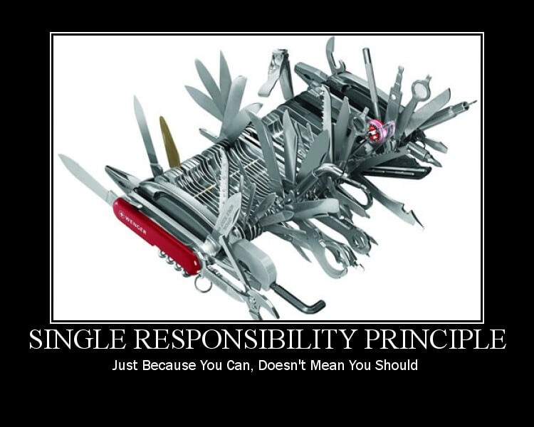
Notes:
5m : 250m
That’s a pretty sweet swiss army knife…

Slide 32
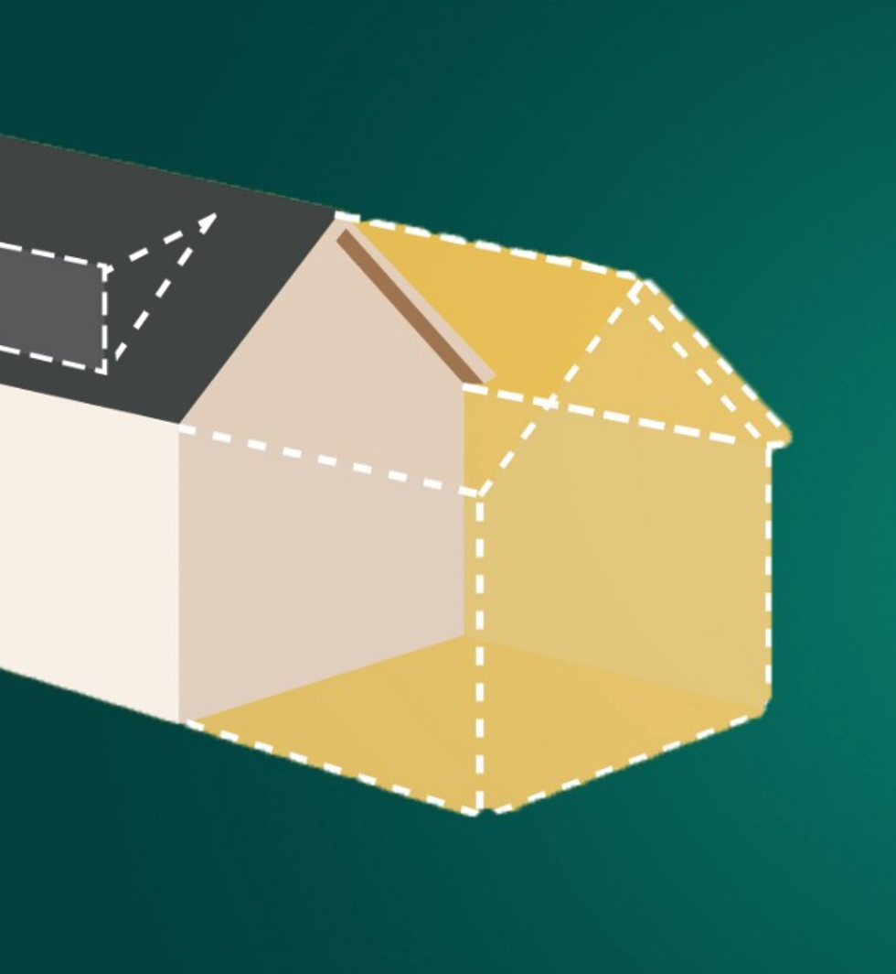
Open-Closed Principle
Objects or entities should be open for extension but closed for modification
32
Notes:
5m : 255m
Doesn’t it feel “rude” to touch a working piece of code?
This means that a class should be extendable without modifying the class itself.

Slide 33
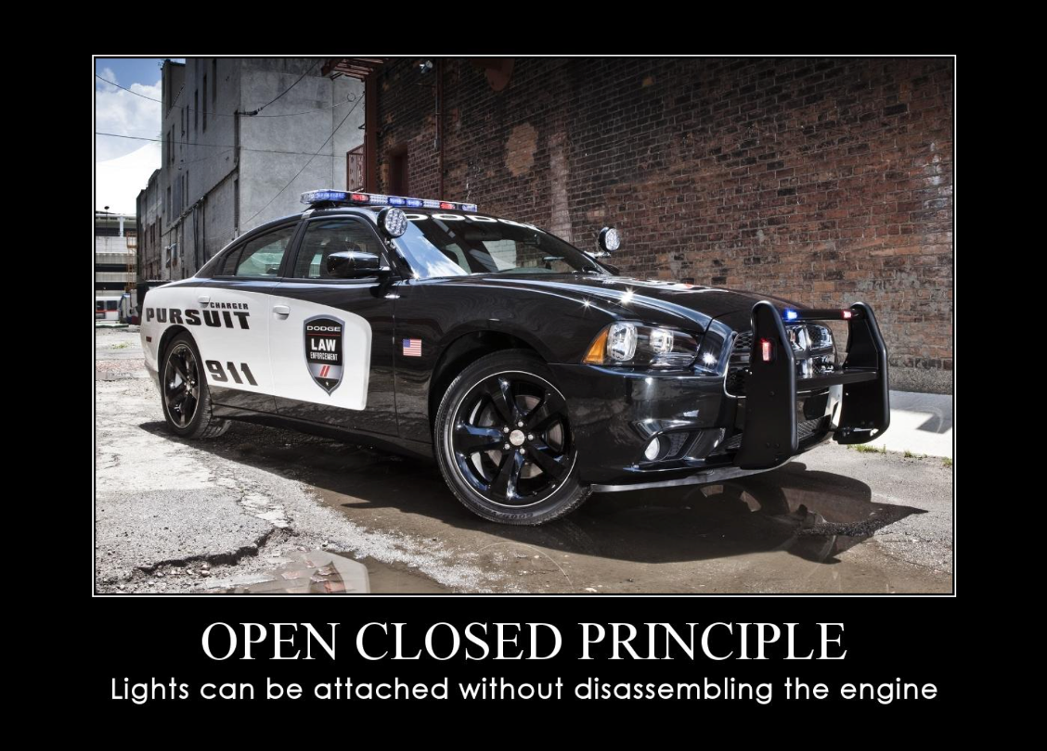
Notes:
5m : 255m
What if mechanics didn’t follow open closed?

Slide 34
Liskov Substitution Principle
Objects of a superclass shall be replaceable with objects of its subclasses without breaking the application
Notes:
5m : 260m
If it looks like a duck, and quacks like a duck, then it is a duck
Why would we define a variable as interface instead of a concrete?
List<String> ducks = new ArrayList<Ducks>();

Slide 35
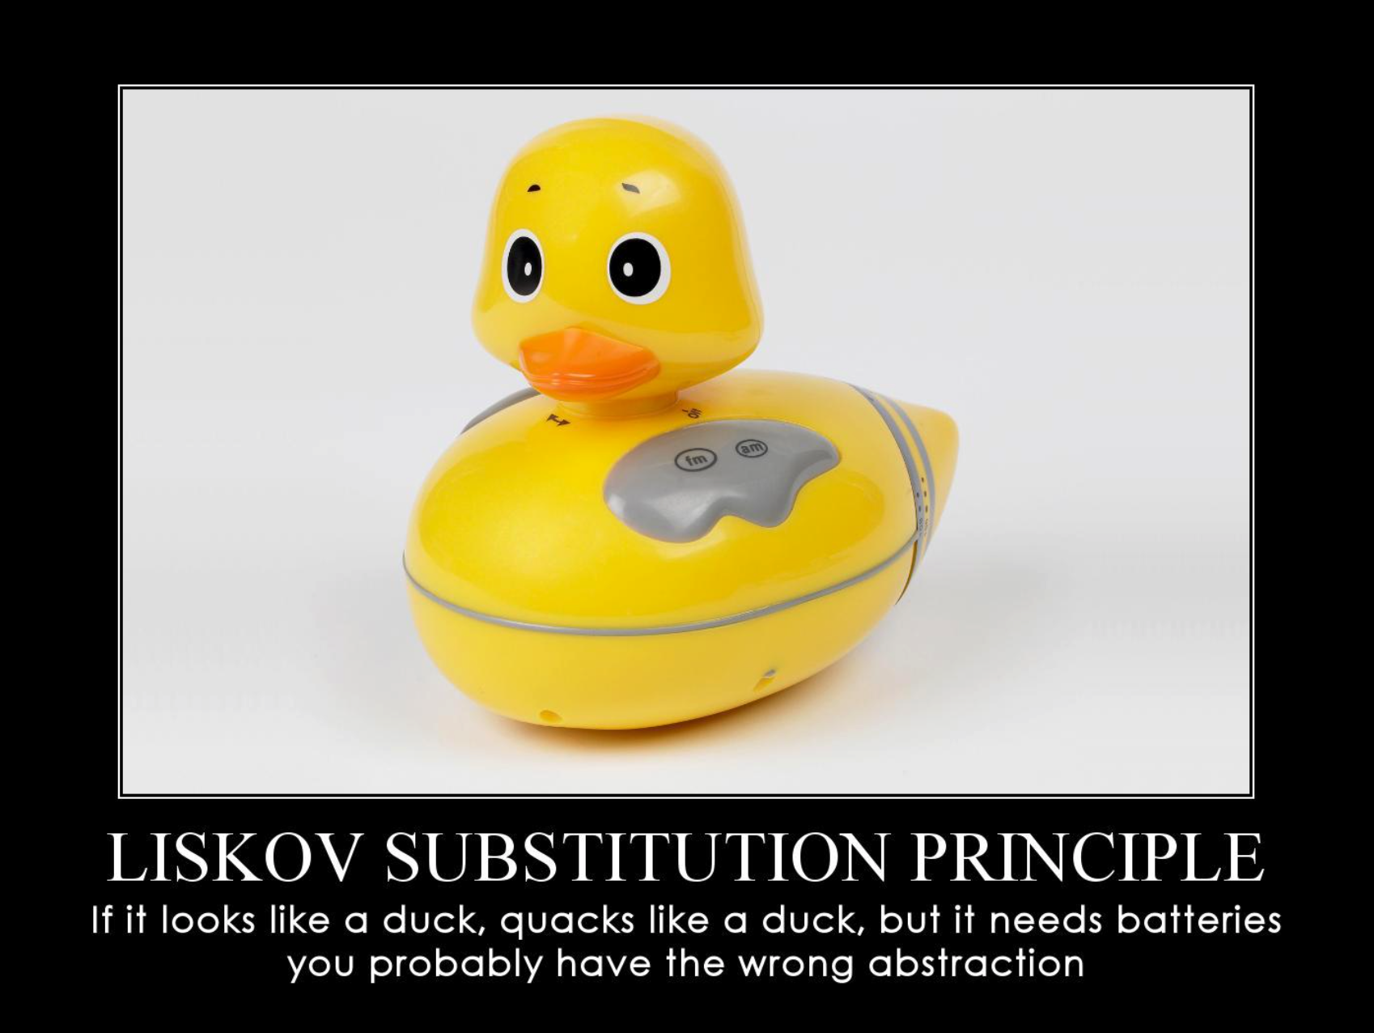
Notes:
5m : 260m
Is this a Duck?

Slide 36
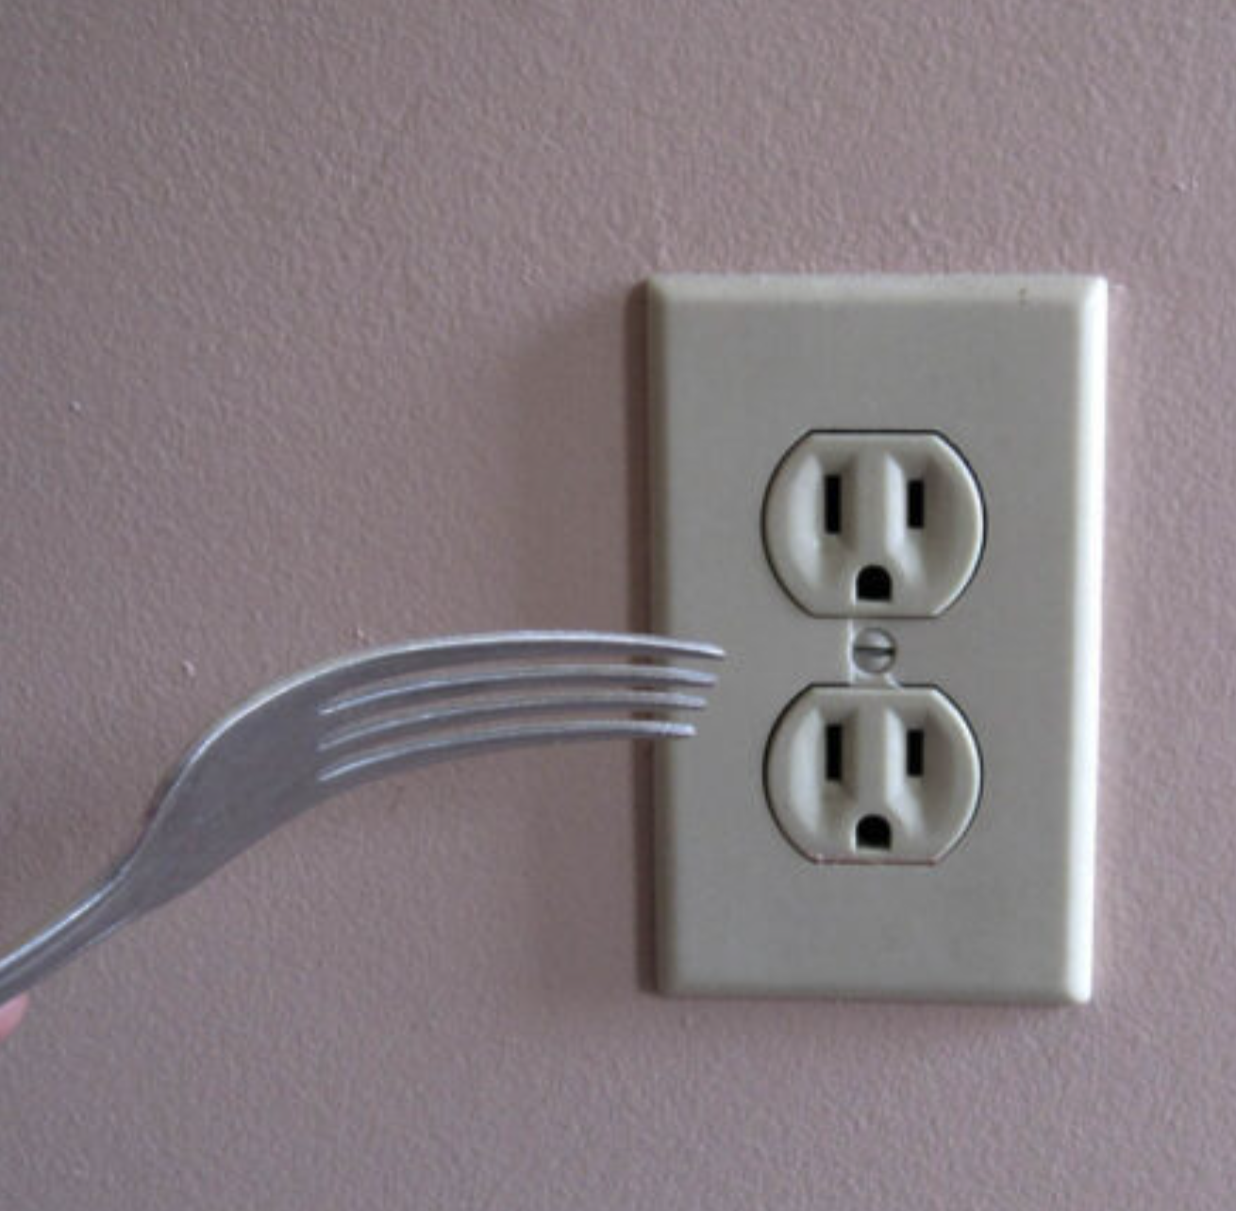
Interface Segregation Principle
A client should never be forced to implement an interface that it doesn’t use, or clients shouldn’t be forced to depend on methods they do not use.
Notes:
5m : 265m
Why would we want smaller specialized interfaces?
Has anyone ever been in a project where there was just one interface for everything?
Class littered with stubs of not implemented exceptions

Slide 37
Notes:
5m : 265m
How useful is this really?

Slide 38
Dependency Inversion Principle
Entities must depend on abstractions, not on concretions. It states that the high-level module must not depend on the low-level module, but they should depend on abstractions
Notes:
5m : 265m
What does inverting our dependency meany?
How do you test a class which has acess to some global context?
- Why not just pass that into the class itself in the constructor
This is the ROOT OF ALL EVIL in legacy systems
- Every time you “new” inside of a class, you are FORCING it to depend on that specific implementation

Slide 39
Notes:
5m : 265m
The socket does not depend upon the lamp, the lamp depends upon the socket

Slide 40
DRY Principle
D - Don’t R - Repeat Y - Yourself
Every piece of knowledge must have a single, unambiguous, authoritative representation within a system.
Notes:
5m : 270m
First introduced in the book The Pragmatic Programmer. The principle itself was known and applied before this book came to life; but the Pragmatic Programmer defined it precisely and coined its name.
Why is duplication the root of all evil?
When would you not want to duplicate something?
When would you want to duplicate something?
Opposite of DRY is WET
W - Write
E - Everything
T - Twice

Slide 41

YAGNI Principle
Y - You A - Ain’t G - Gonna N - Need I - It
Notes:
5m : 275m
Yagni is a way to refer to the XP practice of Simple Design
What is the cost of gold plating? What benefit does this give us?

Slide 42
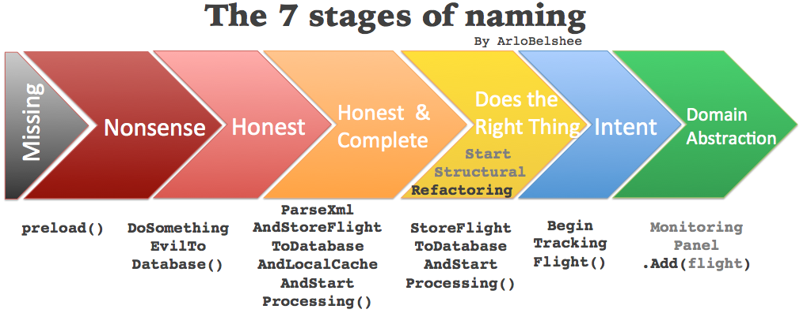
Notes:
5m : 280m
Why are names so important?

Slide 43

BREAK
Notes:
10m : 290m

Slide 44
Kata: Roman Calculator
03_roman_calculator
Notes:
45m : 335m
https://codingdojo.org/kata/RomanCalculator
Problem Description
“As a Roman Bookkeeper I want to add Roman numbers because doing it manually is too tedious.” Given the Roman numerals, (IVXLCDM which mean one, five, ten, fifty, hundred, fivehundred and a thousand respectively), create two numbers and add them. As we are in Ancient Rome there is no such thing as decimals or int, we need to do this with the strings. An example would be “XIV” + “LX” = “LXXIV”
There are some rules to a Roman number:
Numerals can be concatenated to form a larger numeral (“XX” + “II” = “XXII”)
If a lesser numeral is put before a bigger it means subtraction of the lesser from the bigger (“IV” means four, “CM” means ninehundred)
If the numeral is I, X or C you can’t have more than three (“II” + “II” = “IV”)
If the numeral is V, L or D you can’t have more than one (“D” + “D” = “M”)

Slide 45

Review
45
Notes:
15m : 350m
Review class solutions
A little bit more complicated than Fizz Buzz…
Did unit tests help you out in any way?
What if another character number type was added?
Would you be confident you could update your solution to accommodate?

Slide 46

Day 1 - Wrap Up
Notes:
Retrospective / Reflect (if time)

Slide 47
Day Two
Notes:
10m : 10m
Socialize

Slide 48

recap
Notes:
15m : 25m
Utilize practice problems (aka Katas) to develop a baseline level of experience with TDD
Fizz Buzz
Roman Calculator
# Three Laws of Test Driven Development
- You are not allowed to write any production code unless it is to make a failing unit test pass.
- You are not allowed to write any more of a unit test than is sufficient to fail; and compilation failures are failures.
- You are not allowed to write any more production code than is sufficient to pass the one failing unit test.
Fake it till you make it
# ZOMBIES
Z - Zero
O - One
M - Many
B - Boundary Behavior
I - Interface Definition
E - Exercise Exception Behavior
S - Simple
S - Single Responsibility Principle
O - Open / Closed => Open for extension, closed for modification
L - Liskov Substitution => shape.area :: rectangle.area : square.area : circle.area
I - Interface Segregation
D - Dependency Inversion
D - Don't
R - Repeat
Y - Yourself
Y - You
A - Ain't
G - Gonna
N - Need
I - It
Lot of hard work and discipline – shift quality left

Slide 49
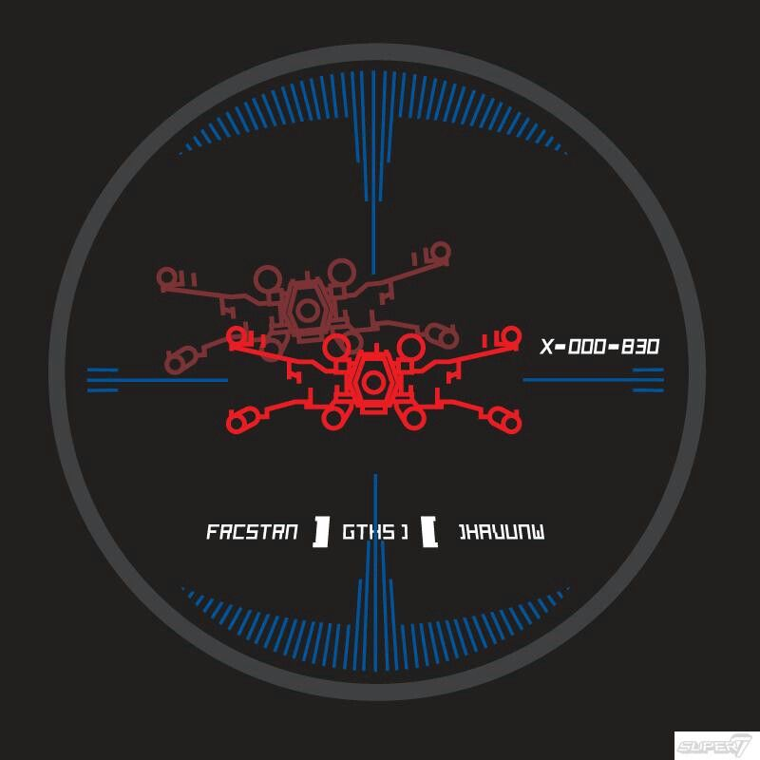
Course Objectives
Summarize the value of TDD
Use TDD to solve Katas
Integrate TDD Into Daily Work
Recognize the benefit of writing clean, maintainable code
Notes:
5m : 30m
How are we doing?

Slide 50

TDD Costs (Perceived)
Takes twice as long
Maintain test and code
Reduced ability to quickly produce quick and dirty prototypes
Notes:
5m : 35m
Takes twice as long
- Reality: easily saves more time
Maintain test and code
- Reality: beats maintaining written detailed docs
Not all that valuable - tough work is in the “wiring”
- Reality: not if classes are designed correctly in the first place
Time wasted on fixing “brittle tests”
Reduced ability to quickly produce quick and dirty prototypes
- Hacker Hat vs Craftsman Hat
- Quality tuned to context

Slide 51
TDD Costs (Real)
Initial learning curve
Continual Learning: How do I test X?
Can promote overconfidence
Maintaining tests can be considerable work
Notes:
5m : 40m
If you have never done TDD, and you go back to work next week and say – from now on I am doing ONLY TDD… probably in for a bad time Greenfield projects and/or well architected projects this may work, but unfortunately most of us have to deal with rough legacy systems
There are situations that are difficult to test – external devices and api’s

Slide 52
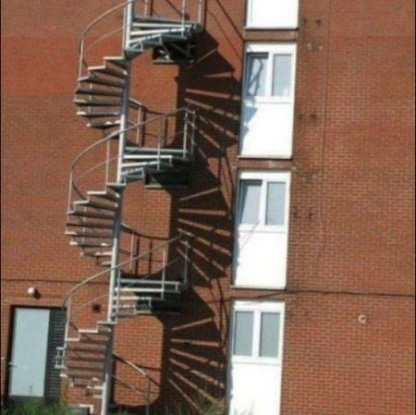
Two Unit Tests No Integration Tests
Notes:
5m : 40m
TDD helps prevent errors in specification, but it often does not look at the integration of those specifications into the system as a whole
There are no silver bullets

Slide 53
TDD Rewards
Higher confidence levels - Continual feedback; Pavlovian response - Ease introduction of new functionality - Allows for refactoring with impunity
Continual progress - Add value every programming session, every few minutes - Avoid going too astray
Notes:
5m : 45m
What is the business value of “higher confidence levels”? - agility
Anyone here ever been stuck on a bug for what seems like hours, or days, when it turns out it was a single line of code that needed changed? - no need to understand the entire system to make a change, tests will catch what is broken

Slide 54
Kata: Bowling
04_bowling
Notes:
45m : 90m
Problem Description
Create a program, which, given a valid sequence of rolls for one line of American Ten-Pin Bowling, produces the total score for the game. Here are some things that the program will not do:
- We will not check for valid rolls.
- We will not check for correct number of rolls and frames.
- We will not provide scores for intermediate frames.
Depending on the application, this might or might not be a valid way to define a complete story, but we do it here for purposes of keeping the kata light. I think you’ll see that improvements like those above would go in readily if they were needed for real.
We can briefly summarize the scoring for this form of bowling:
- Each game, or “line” of bowling, includes ten turns, or “frames” for the bowler.
- In each frame, the bowler gets up to two tries to knock down all the pins.
- If in two tries, he fails to knock them all down, his score for that frame is the total number of pins knocked down in his two tries.
- If in two tries he knocks them all down, this is called a “spare” and his score for the frame is ten plus the number of pins knocked down on his next throw (in his next turn).
- If on his first try in the frame he knocks down all the pins, this is called a “strike”. His turn is over, and his score for the frame is ten plus the simple total of the pins knocked down in his next two rolls.
- If he gets a spare or strike in the last (tenth) frame, the bowler gets to throw one or two more bonus balls, respectively. These bonus throws are taken as part of the same turn. If the bonus throws knock down all the pins, the process does not repeat: the bonus throws are only used to calculate the score of the final frame.
- The game score is the total of all frame scores.
More info on the rules at: [How to Score for Bowling](https://www.topendsports.com/sport/tenpin/scoring.htm)

Slide 55
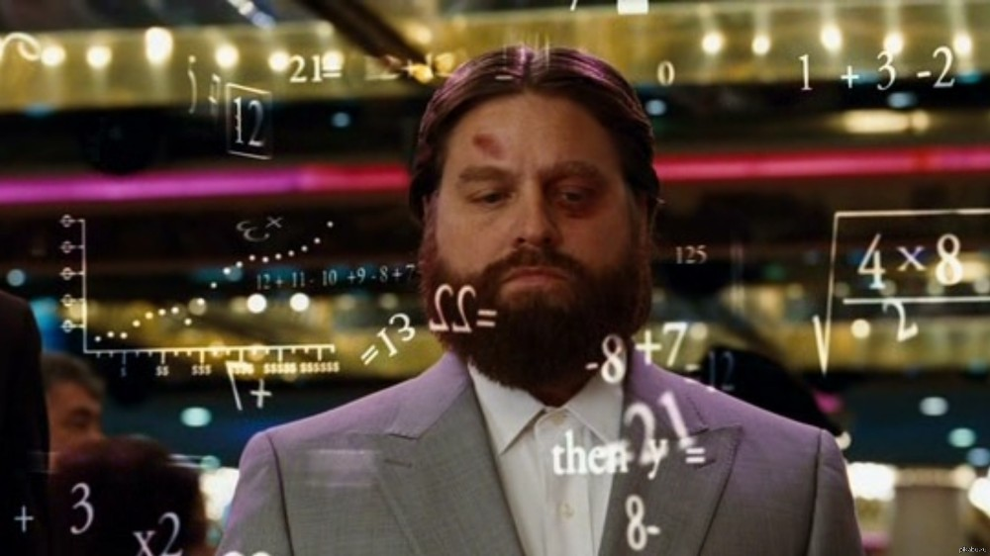
Review
Notes:
15m : 105m

Slide 56

BREAK
Notes:
10m : 115m

Slide 57

TDD So Far...
How does it help? - Based upon what you’ve learned so far Testing all the time Design all the time - Build classes in isolation - Consistently adapt to changing requirements That’s only part of it…
Notes:
5m : 120m
We have done four separate excercises… for some, this may be the first unit tests ever written
What does it feel like we are missing?

Slide 58
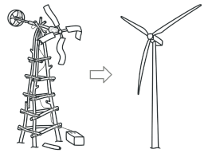
Refactoring
Restructure (the source code of an application or piece of software) to improve operation without altering functionality
Notes:
5m : 125m
Has anyone here misued, or heard someone else, the term “refactoring”?
Ensure all previous tests are still passing
Clean up the code without adding new functionality
Address readability, naming
Remove duplication

Slide 59
Refactoring
Ensure code has optimal design always - Another way to do “agile” design
Entropy is unavoidable - Deal with it all along product lifecycle Code transformations, not performance optimizations Take small, safe steps The third, critical leg of the TDD cycle
Notes:
5m : 130m
Code changes during refactoring should NOT change external behavior of code

Slide 60
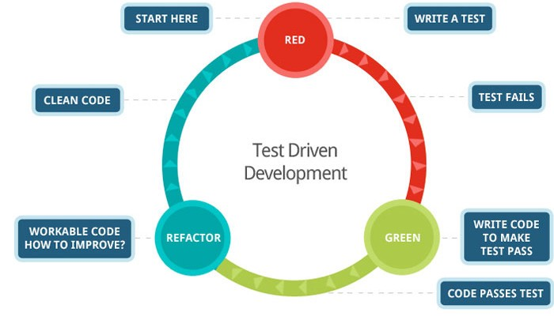
Red, Green, Refactor
Notes:
5m : 135m
We have been working on the Red-Green loop, but it feels like something is missing?
How does Refactoring tied into TDD?

Slide 61
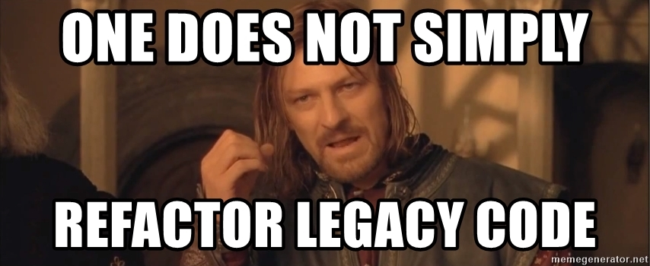
Notes:
0m : 135m
So how do we do this in production code?

Slide 62
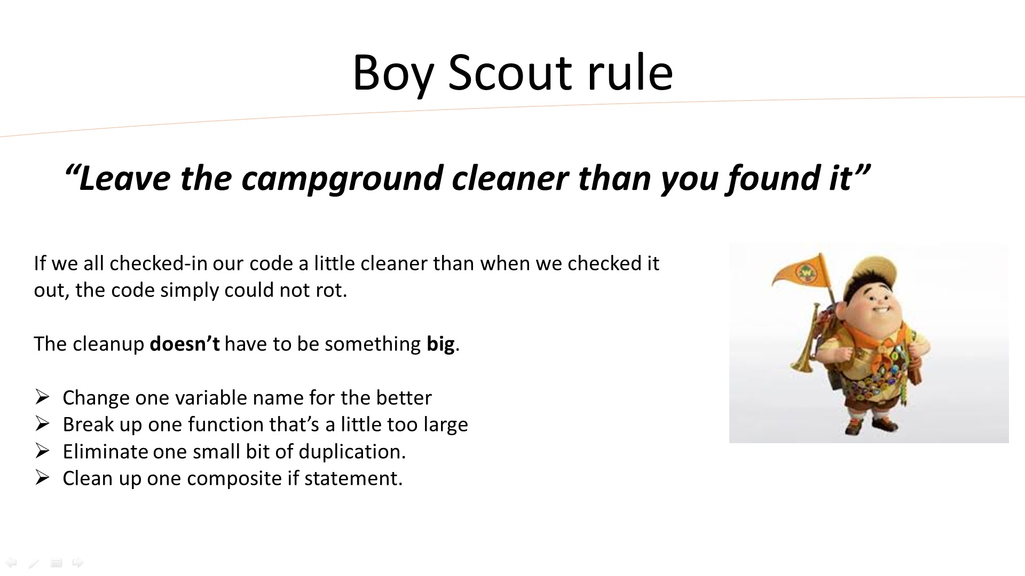
Notes:
5m : 140m

Slide 63
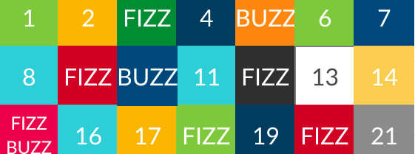
Refactoring Fizz Buzz
What if we wanted to make it so that multiples of seven go “Pop”?
Based upon our current implementation, having to add another command violates the open closed principle…
Notes:
5m : 145m
How could we refactor our code such that this is possible?
What if not just multiples of 3 or 5, we decided if the number has a 3 or 5 in it, then it should Fizz or Buzz?

Slide 64
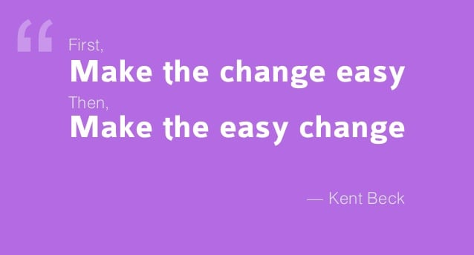
Notes:
5m : 150m
Is anyone here familiar with design patterns?
Which design patterns could we use such that we could refactor a FizzBuzz solution to allow for Pops?

Slide 65
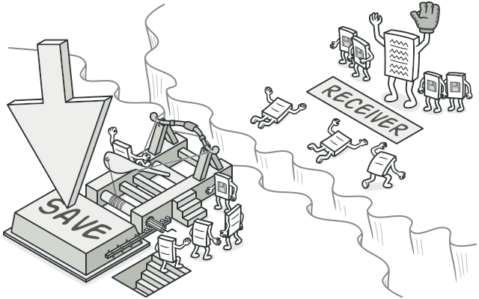
Abstract Factory
https://refactoring.guru/
Command
05_fizz_buzz_command
Notes:
20m : 170m
Abstract Factory is a creational design pattern that lets you produce families of related objects without specifying their concrete classes.
- Encapsulate object creation into its own single responsibility
Command is a behavioral design pattern that turns a request into a stand-alone object that contains all information about the request. This transformation lets you pass requests as a method arguments, delay or queue a request’s execution, and support undoable operations.
- Encapsulate object behavior
Start out with 100% code coverage
`yarn test:coverage`

Slide 66

Review
Notes:
5m : 175m
Was that different than how anyone else implemented their Fizz Buzz solution?

Slide 67

BREAK
Notes:
10m : 185m

Slide 68
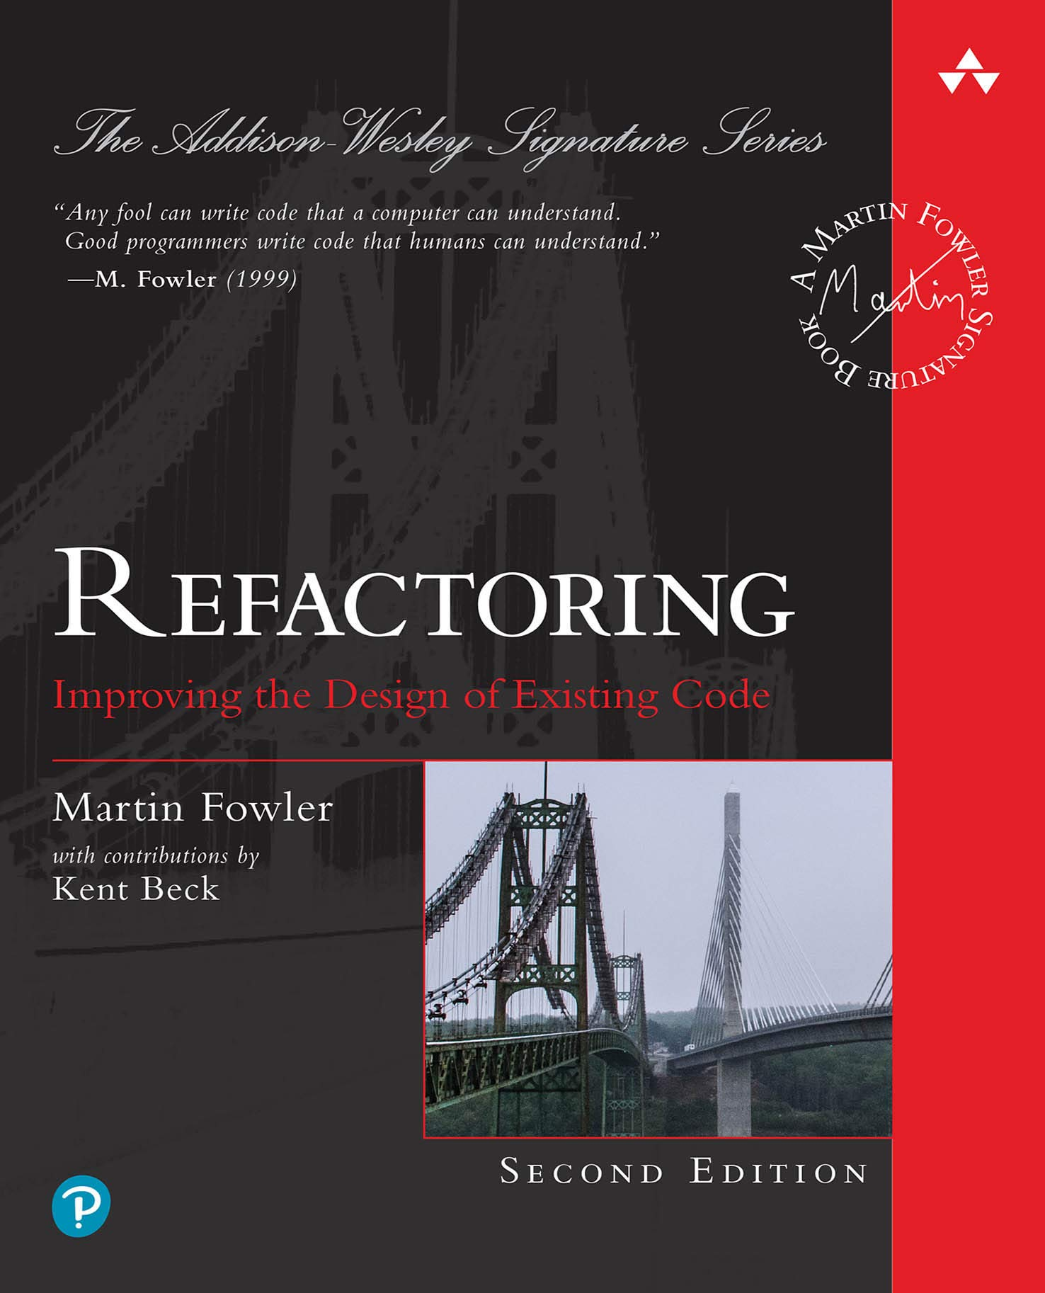
Notes:
2.5m : 187.5m
Has anyone read this book?
I have read the first edition, but the second edition is all in JavaScript!

Slide 69
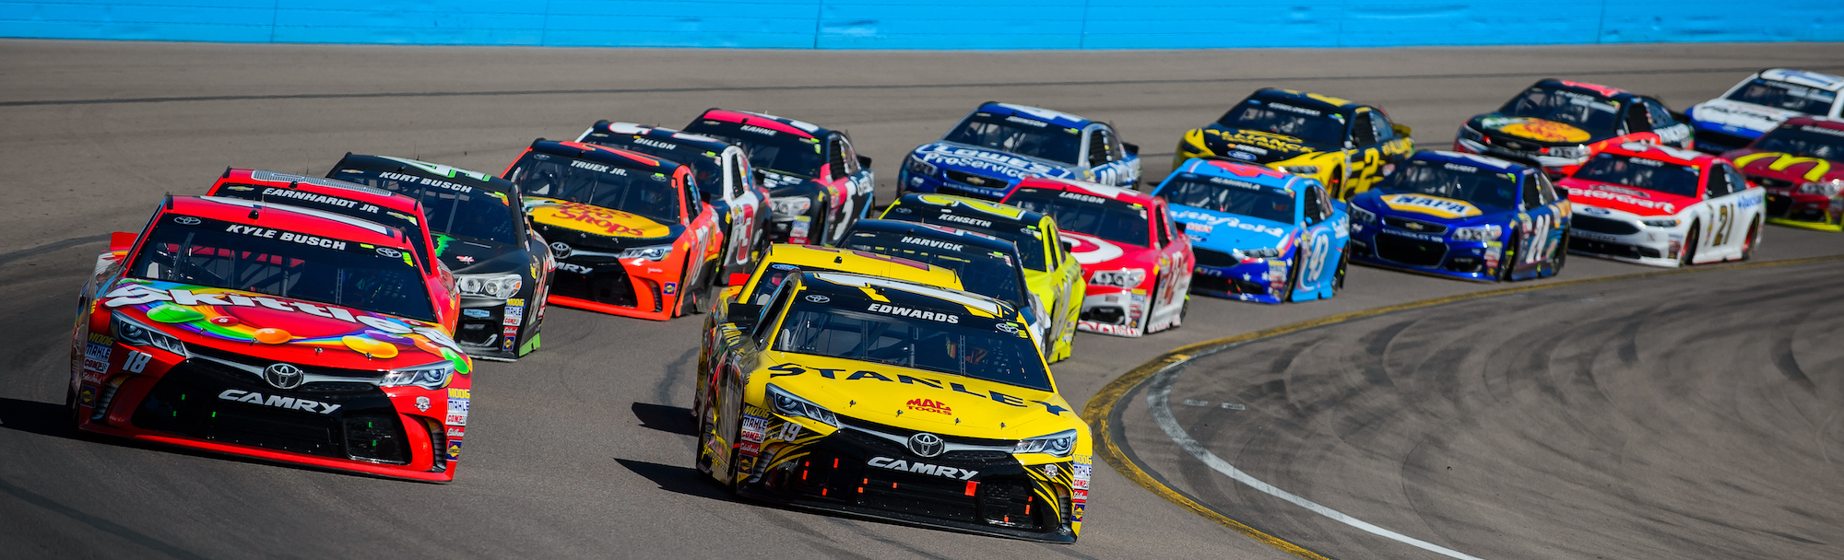
Refactoring Drivers
Code Smells
Classic design principles – SOLID, DRY, etc
Design Patterns (Gang of Four)
Notes:
7.5m : 195m
Does anyone here know what a code smell is?
- Have you ever stumbled across a piece of code that made you do a double take?
Why would we want to alter existing code to align with a design principle?
Can anyone here name a few design patterns, and talk about what problem it solves?

Slide 70
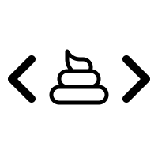
Code Smells
“Code smells are usually not bugs; they are not technically incorrect and do not prevent the program from functioning. Instead, they indicate weaknesses in design that may slow down development or increase the risk of bugs or failures in the future. Bad code smells can be an indicator of factors that contribute to technical debt.”
"When and Why Your Code Starts to Smell Bad"
2015 37th IEEE International Conference on Software Engineering (ICSE).
Notes:
2.5m : 197.5m
If it is not “technically incorrect”, why change it?

Slide 71
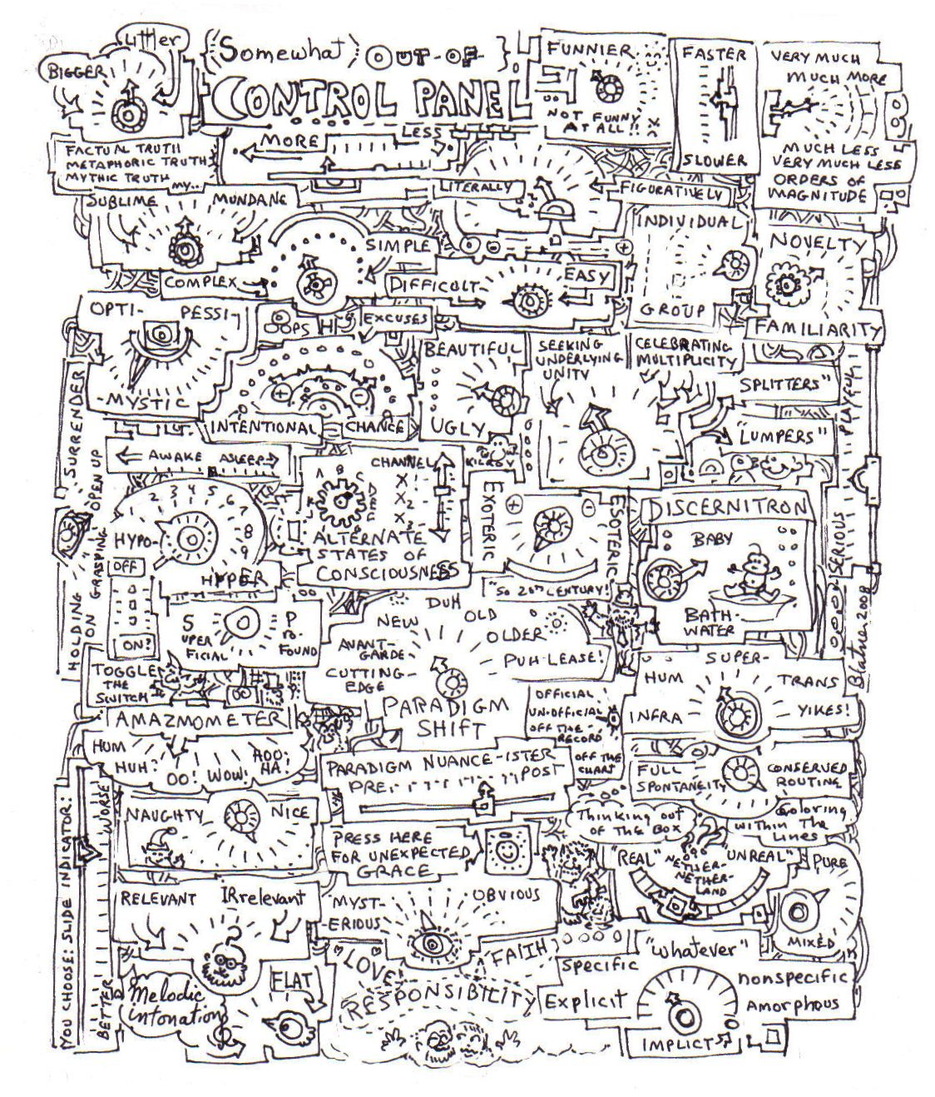
Recognize You Have a Problem
Long Method smell (Fowler)
Not very expressive, contains duplication (Simple Design)
Contains guiding comments (Simple Style)
Breaks the Single Responsibility Principle (Martin)
Notes:
7.5m : 205m
The first step in recovery is recognizing you have a problem
Why would each of these be a problem (aka a smell)

Slide 72
Application-level Smells
Duplicated code
Contrived complexity
Shotgun surgery
Notes:
5m : 210m
Duplicate code: Identical or very similar code exists in more than one location.
Contrived complexity: Forced usage of over complicated design patterns where simpler design would suffice.
Shotgun surgery: A single change needs to be applied to multiple classes at the same time.

Slide 73
Class-level Smells
Large class
Feature envy
Inappropriate intimacy
Excessive use of literals
Cyclomatic complexity
Notes:
5m : 215m
Large class: a class that has grown too large. See God object.
Feature envy: a class that uses methods of another class excessively.
Inappropriate intimacy: a class that has dependencies on implementation details of another class.
Excessive use of literals: these should be coded as named constants, to improve readability and to avoid programming errors.
Additionally, literals can and should be externalized into resource files/scripts, or other data stores such as databases where possible, to facilitate localization of software if it is intended to be deployed in different regions.
Cyclomatic complexity: too many branches or loops; this may indicate a function needs to be broken up into smaller functions, or that it has potential for simplification.

Slide 74
Method-level Smells
Too many parameters
Long method
Excessively long identifiers
Excessively short identifiers
Excessive return of data
Excessively long line of code
Notes:
5m : 220m
Too many parameters: a long list of parameters is hard to read, and makes calling and testing the function complicated.
It may indicate that the purpose of the function is ill-conceived and that the code should be refactored so responsibility is assigned in a more clean-cut way.
Long method: a method, function, or procedure that has grown too large.
Excessively long identifiers: in particular, the use of naming conventions to provide disambiguation that should be implicit in the software architecture.
Excessively short identifiers: the name of a variable should reflect its function unless the function is obvious.
Excessive return of data: a function or method that returns more than what each of its callers needs.
Excessively long line of code: A line of code which is so long, making the code difficult to read, understand, debug, refactor, or even identify possibilities of software reuse.

Slide 75

Refactoring Tips
Don’t refactor and change behavior simultaneously
Always run tests - If tests aren’t available, take only safe proven steps
Never skip the third leg of the TDD cycle - Avoid having to ask permission - Refactoring is part of your development process
Notes:
5m : 225m
What are ”safe proven steps”?

Slide 76

Read by Refactoring
Rename
Inline
Extract Method
Introduce Local Variable
Introduce Parameter
Introduce Field
Notes:
5m : 230m
Read by Refactoring is a technique discussed and taught by Arlo Belshee (@arlobelshee) at Industrial Logic. Using this technique, reading code – to figure out what it does, to estimate the effort to modify it, etc. – turns into active refactoring of the code. You read the code by modifying it, nudging it into a clearer, more readable state. The key is you are leveraging your IDE’s built in refactoring functions and mastering the keyboard shortcuts in such a way that your insights of how the code can be improved translate immediately into modification of the code.

Slide 77
Incremental Change
Look at something
Have an insight
Write it down (in code)
Check it in
Notes:
5m : 235m
The key to read by refactoring is the additive benefits of many small changes. Legacy code or unfamiliar code is too complex to allow discovery of big insights into how to make it better. Instead, small changes, made safely, step by step, transform code into a better state.
This is a tight, quick, loop – limited only by the speed at which you have insights and refactor the code. Keep in mind, each loop is a small step. Maybe the first insight is to rename a method so it better describes what it does. That’s a check-in. Next, you inline a variable to increase readability. That’s a check-in. You’ll find yourself doing dozens of check-ins per hour. Each of them small, and each of them safe. Each of them easily rolled back if something goes wrong or you need change direction.

Slide 78
Benefits
Rapid Development
Every time you read code; you improve it
Refactoring becomes ingrained in the culture
Greater agility
Notes:
5m : 240m
Rapid Development – Safe changes can be merged directly to master without code reviews and QA (mostly).
Every time you read code; you improve it. Examining code is no longer passive – you gain understanding of how it works, and you leave it better than you found it.
Refactoring becomes ingrained in your culture – a part of your daily development flow and no longer a separate task you hope to get to some day.
This new-found ease with refactoring leads to lower costs for refactoring and thus lower costs for design mistakes/changes. This allows for greater agility.

Slide 79

BREAK
Notes:
10m : 250m

Slide 80
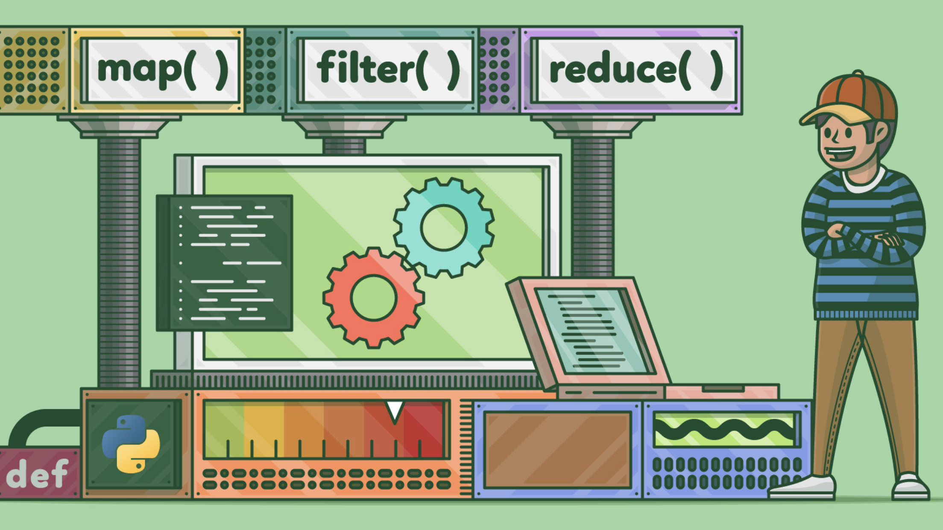
Kata: Fizz Buzz
06_fizz_buzz_functional
Notes:
15m : 265m
http://codingdojo.org/kata/FizzBuzz
Since we did this one earlier, it should go quicker – right?
The best way to practice TDD, is to start the day off with a small timeboxed exercise – the purpose is to practice, NOT to finish FizzBuzz is pretty quick, so we are going to timebox this at 15m
This time, no looping

Slide 81

Review
Notes:
5m : 270m
How was that implementation different than the rest of our Fizz Buzz solutions so far?

Slide 82
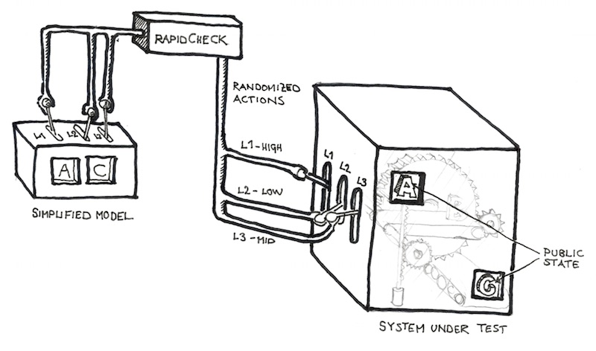
SUT – System Under Test
The thing we’re currently writing Unit Tests for
Can have 1 or more dependencies (Fowler calls them “collaborators”)
Notes:
2.5m : 267.5m
When we say unit test, what are testing?
We want to create a shared vocabulary such that everyone understands what the “system” is In addition, when we have dependencies, we can reference them as “collaborators” to the system

Slide 83
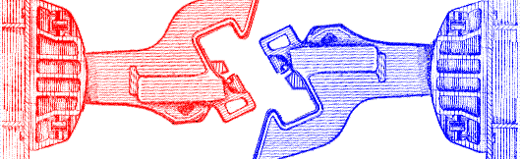
Dependencies, Decoupled...
You want to isolate the SUT as much as possible!
Building an entire app object graph just for Unit Testing is not practical
Databases should never be a part of a Unit Test!
Notes:
2.5m : 270m
Loose Coupling Saves Lives!

Slide 84
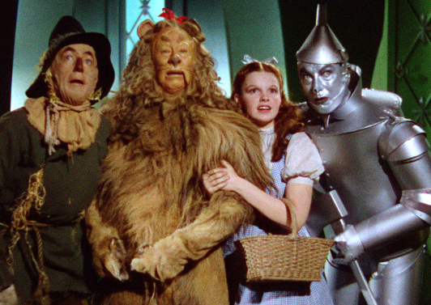
Mocks and Fakes and Stubs, Oh My!
All the same thing: objects that simulate the behavior of real objects
This is how we decouple the “collaborators” from the SUT
Allows us to go beyond simply verifying just the state of the SUT
Opens the door to let us verify the behavior of the SUT

Slide 85
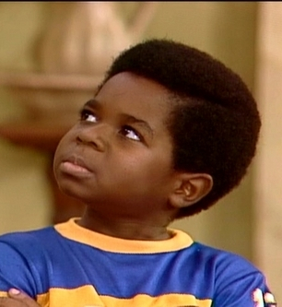
Mocks vs Stubs vs Fakes
Stubs can be thought of having minimalistic behavior – just enough to allow the object under test to execute the test
A Mock is like a “smart” Stub in that the test will also verify that the object under test calls the mock as expected
A Fake has business behavior. You can drive a fake to behave in different ways by giving it different data
Notes:
Welcome to a controversial topic!
Wha'choo talkin' 'bout, Willis?

Slide 86
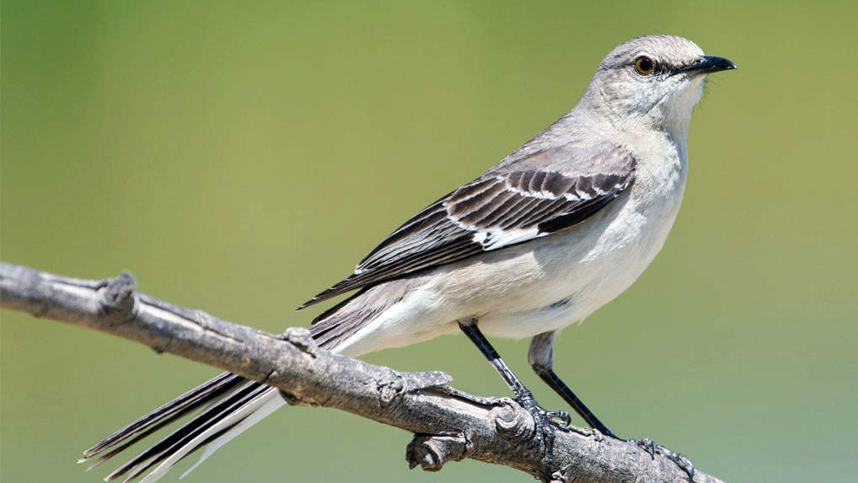
Mocks – How to use them
Most languages have a mocking framework available to use
Mocks and Stubs are easily created with a mocking framework
A Fake is usually easier to code by hand, but can still be done with a mocking framework

Slide 87

Kata: Widget Mock
07_widget_mock
Notes:
30m : 235m
http://codingdojo.org/kata/FizzBuzz
Since we did this one earlier, it should go quicker – right?
The best way to practice TDD, is to start the day off with a small timeboxed exercise – the purpose is to practice, NOT to finish FizzBuzz is pretty quick, so we are going to timebox this at 15m
This time, no looping

Slide 88

SOFTWARE DESIGN & TDD

Slide 89

Software Development Activities
Software development requires:
Analysis, design, coding, testing, review, documentation, planning, deployment, etc.
Absence of any one of these is hacking
Waterfall attempts to serialize these
Agile Solution: Learn to do all activities all the time

Slide 90
Upfront Design
We still do it
Mostly at planning meetings
But with less details
Design insights often only occur when coding
UML Sketches
“Inception” level diagrams
Help Solve the problem but don’t completely specify the code

Slide 91
Design
Design principles and patterns
- vs -
Simple design
BDUF (Big Design Up Front)
- vs -
Emergent design

Slide 92
SIMPLE EVOLUTIONARY DESIGN

Slide 93

Simple Design
Runs all tests
No duplication
Expresses intent
Minimal number of classes & methods

Slide 94
Simple Design
Implies use of TDD
TDD promotes “tell don’t ask”
TDD pushes you to think about “how do I test this class in isolation?”
Minimizes coupling: the core of good OO design
Implies the system works as designed
Automated tests prove it

Slide 95
Simple Design: Expresses Intent
Directly relates to maintenance costs
Core idea behind design patterns
Communicating ideas using common terms / solutions
Promotes single responsibility principle

Slide 96
Simple Design: Minimal Number of Classes & Methods
Prevents over design
You don’t build things into the system that aren’t needed
Stopgap measure
Sometimes methods and classes don’t pull their own weight

Slide 97
It is Agile Software Design!
“Just enough” up-front design
Constant test-first unit testing
Constant attention to design impacts
Ruthless refactoring
It’s only code!
Malleable
Keep as clean as possible to ease addition of new features

Slide 98
Documentation Artifacts
Cost money!
Introduce into plan and estimate
Make executable where possible
Unit tests can supplant code specs, heredocs, design docs
Acceptance tests can supplant use cases, requirements docs

Slide 99
OTHER CONSIDERATIONS

Slide 100

How Big is a Test Method?
Multiple asserts might be a code smell
Could be too much in one test
Test functionality, not methods
Could suggest deficient design
Look to decouple behavior of classes under test
Underlying code may be linked
Look to combine into common assert method
One assert / test is a goal, not a rule

Slide 101
How Big is a Test Class?
Generally one test class per production class
But you can create more than one if necessary...
Organize around common setup
Need for these multiple test “fixtures” might suggest the need for a redesign

Slide 102
The 10 Minute Rule
TDD promotes consistent pacing
Expect a green bar at least every 10 minutes
Otherwise you kill the pace
Resist firing up the debugger on your code
A good tactic:
Discard all new code since the last green bar
Start over, taking even smaller steps

Slide 103
10 Minute Rule Implications
Tests must run fast
Rapid feedback is critical to TDD
Many TDD systems run thousands of tests in under 3 minutes

Slide 104
If Your Tests Run Sloooooww
Look at pervasive bad dependencies
Usually Database, File or other external IO
Improve design
Corral Data Access code
Introduce mocking where needed
Concession: run subsets of tests
Run at the largest possible scope
Isolate certain kinds of tests
Increases Risk

Slide 105
Testing Private Behavior
Often suggests need for redesign
Private methods become public tested methods on another class
If absolutely necessary, relax access specifier

Slide 106
Testing Private Data
Verifying behavior requires inspecting state
Sometimes you wouldn’t normally expose this state
Relax access specifier
No worries - we have tests!

Slide 107
LEGACY CODE & TDD

Slide 108
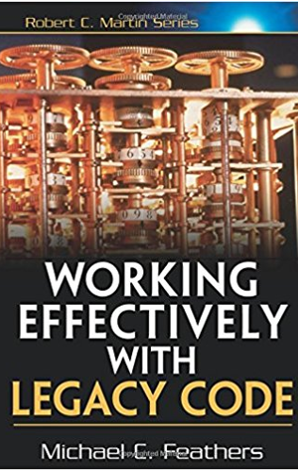
It’s a Catch-22
Existing systems do not have tests
We need tests in order to change code
In order to write tests, we often need to change code
Notes:
What is Legacy Code? Michael Feathers defines it as: code without tests
approval tests
Code seams

Slide 109

Introducing Unit Tests to Legacy Code
Identify change points
Requires good understanding of system design
Find test points
Based on analysis of effects
Break dependencies using safe refactoring techniques
Write tests
Make changes and refactor
Notes:
approval tests

Slide 110
Effects Analysis
Identify method that will change
If it has a return value, examine its callers
Determine if it modifies any values
If so, examine methods that use those values
Also examine methods that use those methods
Make sure you examine super/subclasses
Examine parameters to the methods
Examine global variables and static data modified in any of the identified methods
Notes:
approval tests

Slide 111
Breaking Dependencies
Two reasons to break dependencies when putting tests into place
To sense - when we can’t access computation results
To separate - when we can’t get code to run in a test harness
Primary technique - fake collaborators
Impersonate a collaborator of the class under test
Notes:
approval tests

Slide 112
Some Dependency Breaking Techniques
Break Out Method Object
Move a large method to new class
Local variables in original method become fields
Extract Interface
Create an Interface for some subset of methods
Create fake based upon this interface
Introduce Instance Delegator
Solves problem of “static cling”
Opposite of Expose Static Method
Notes:
approval tests

Slide 113
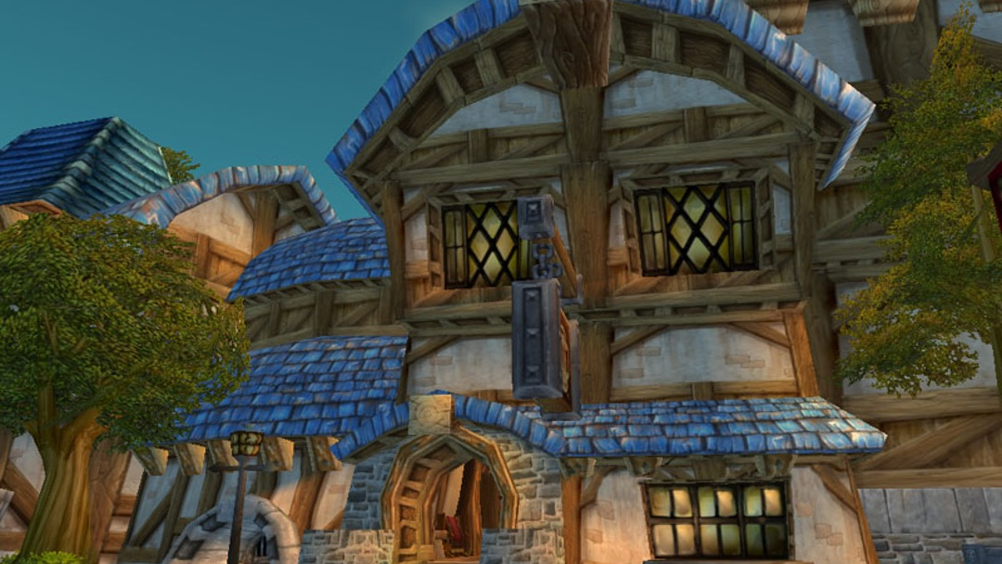
Kata: Gilded Rose
08_gilded_rose
Notes:
45m : 380m
https://github.com/emilybache/GildedRose-Refactoring-Kata/
The basic gist of the kata is this: Here is a piece of crappy legacy code that works.
The customer wishes you to implement and some constrains you need to adhere to.

Slide 114

Review
Notes:
10m : 390m
How was that one?
Anyone have any interesting solutions or findings?

Slide 115

THE END
Notes:
30m : 420m
Course Objectives:
Summarize the value of TDD
Use TDD to solve Katas
Integrate TDD Into Daily Work
Recognize the benefit of writing clean, maintainable code
Going Forward:
Team determines policy going forward
“All new code written using tests”
“Code without tests must be inspected”
Concentrate on legacy code that is causing problems or is the most difficult to modify
Consider pairing
Helps ingrain techniques
Ensures adherence
Final Thoughts: TDD is here to stay
A satisfying and enriching practice that can dramatically increase the quality of your application
Diligent adherence to practice is required to succeed
But the benefits are worth it
Retrospective?

